Slide 1
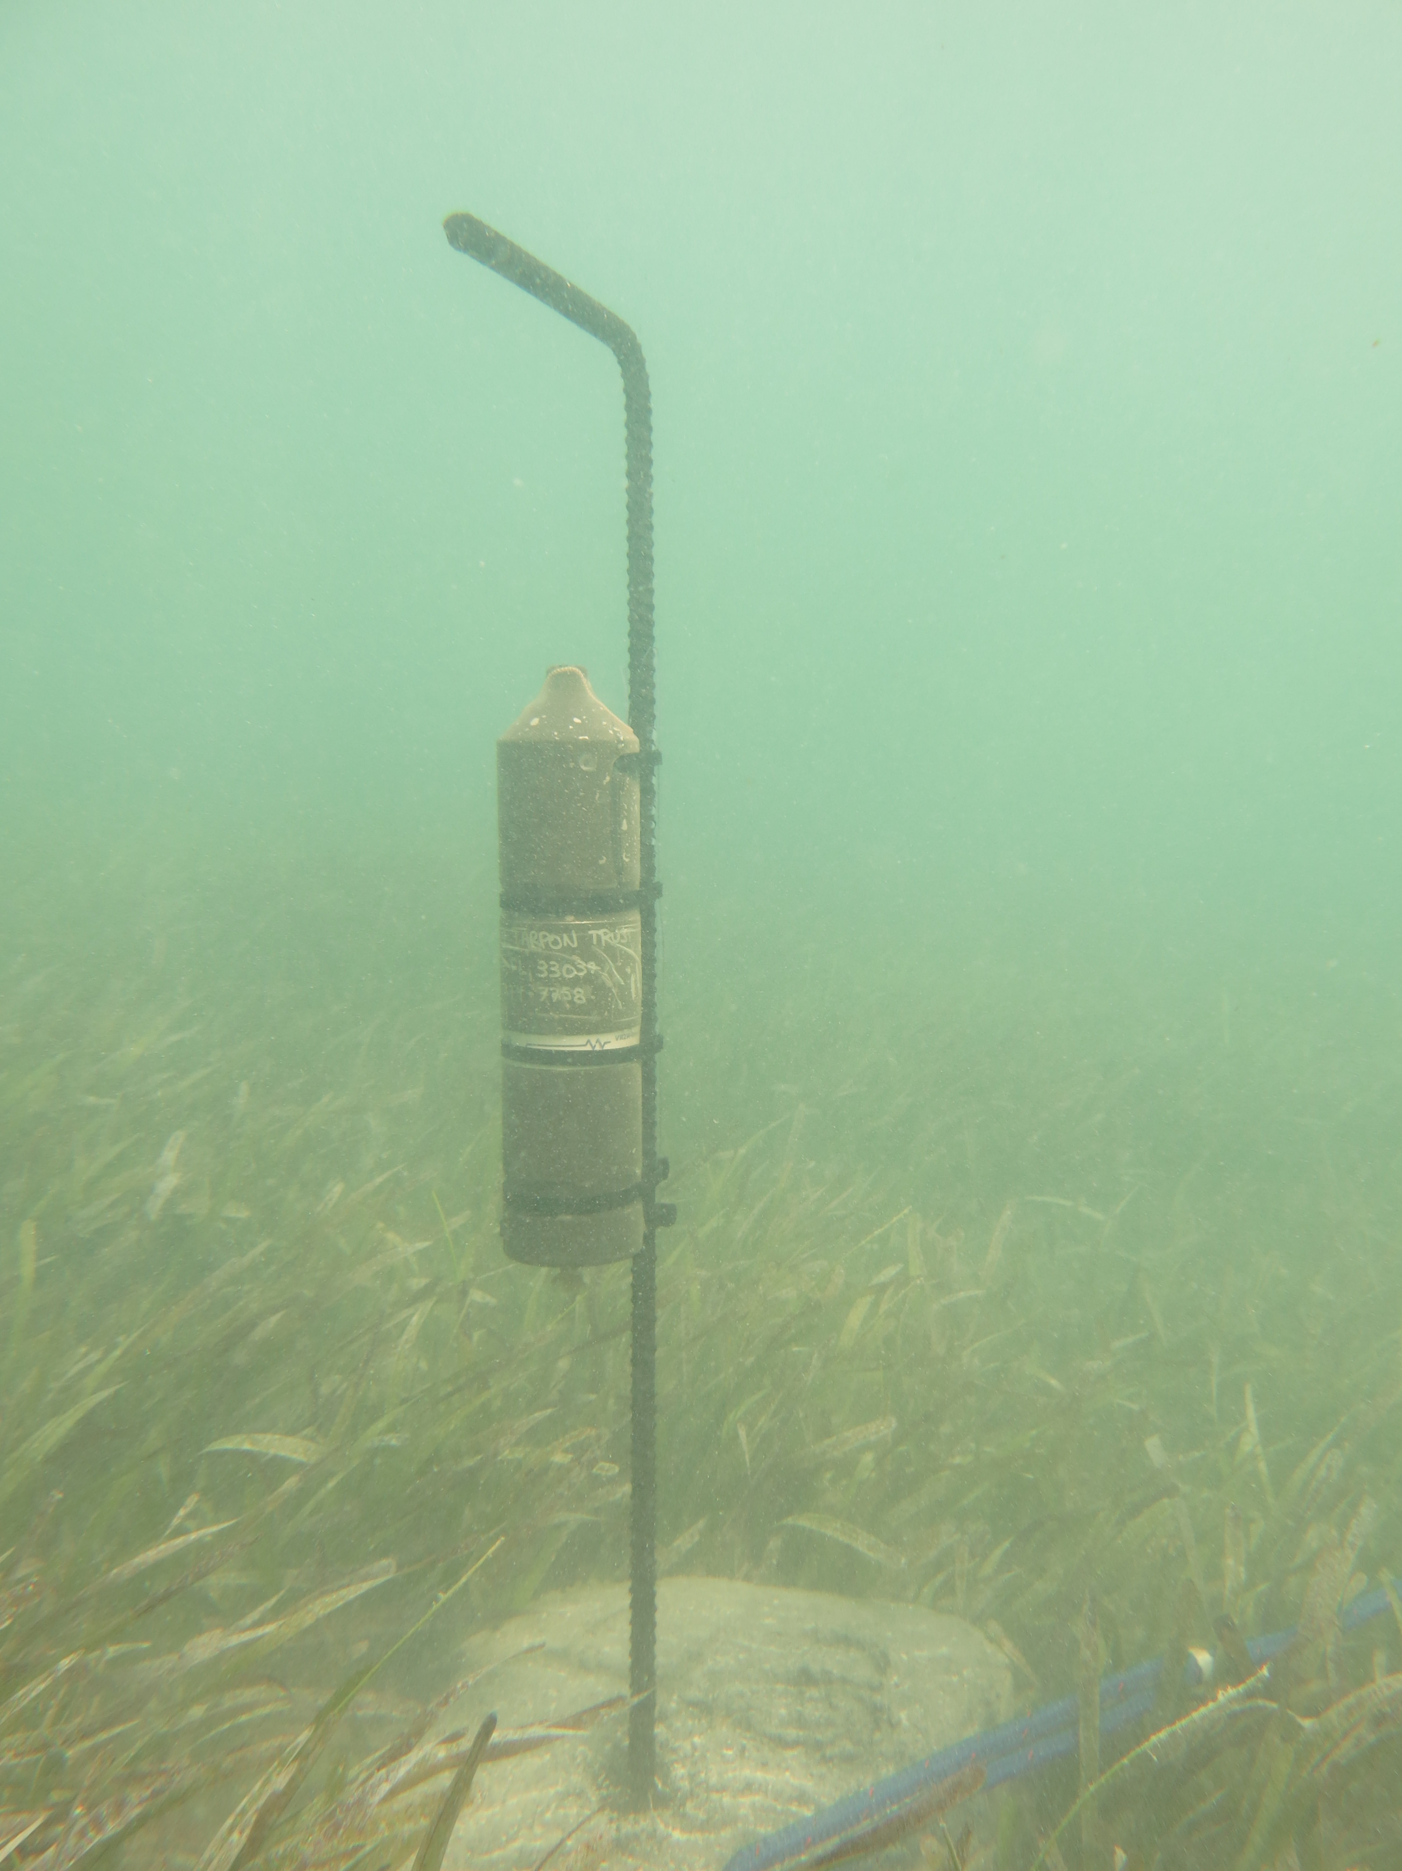
Introduction to Acoustic Telemetry Data Analysis
Jake Brownscombe, PhD
Banting Postdoctoral Fellow
Dalhousie University

Slide 2
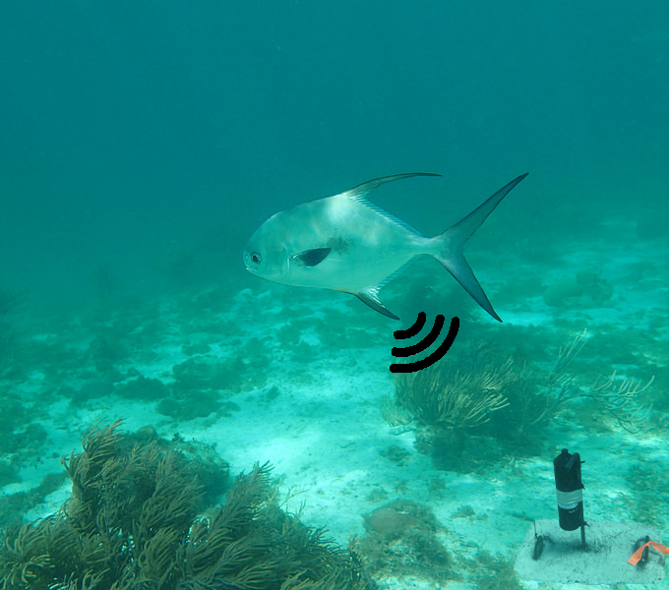
Permit (Trachinotus falcatus)

Slide 3
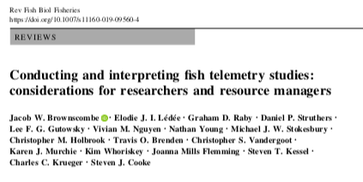
Permit (Trachinotus falcatus)

Slide 4
Permit (Trachinotus falcatus)

Slide 7
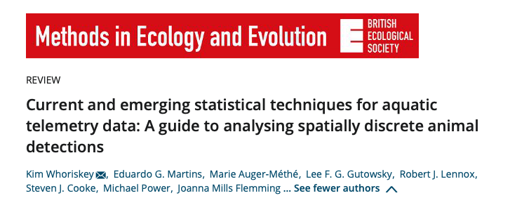

Slide 9
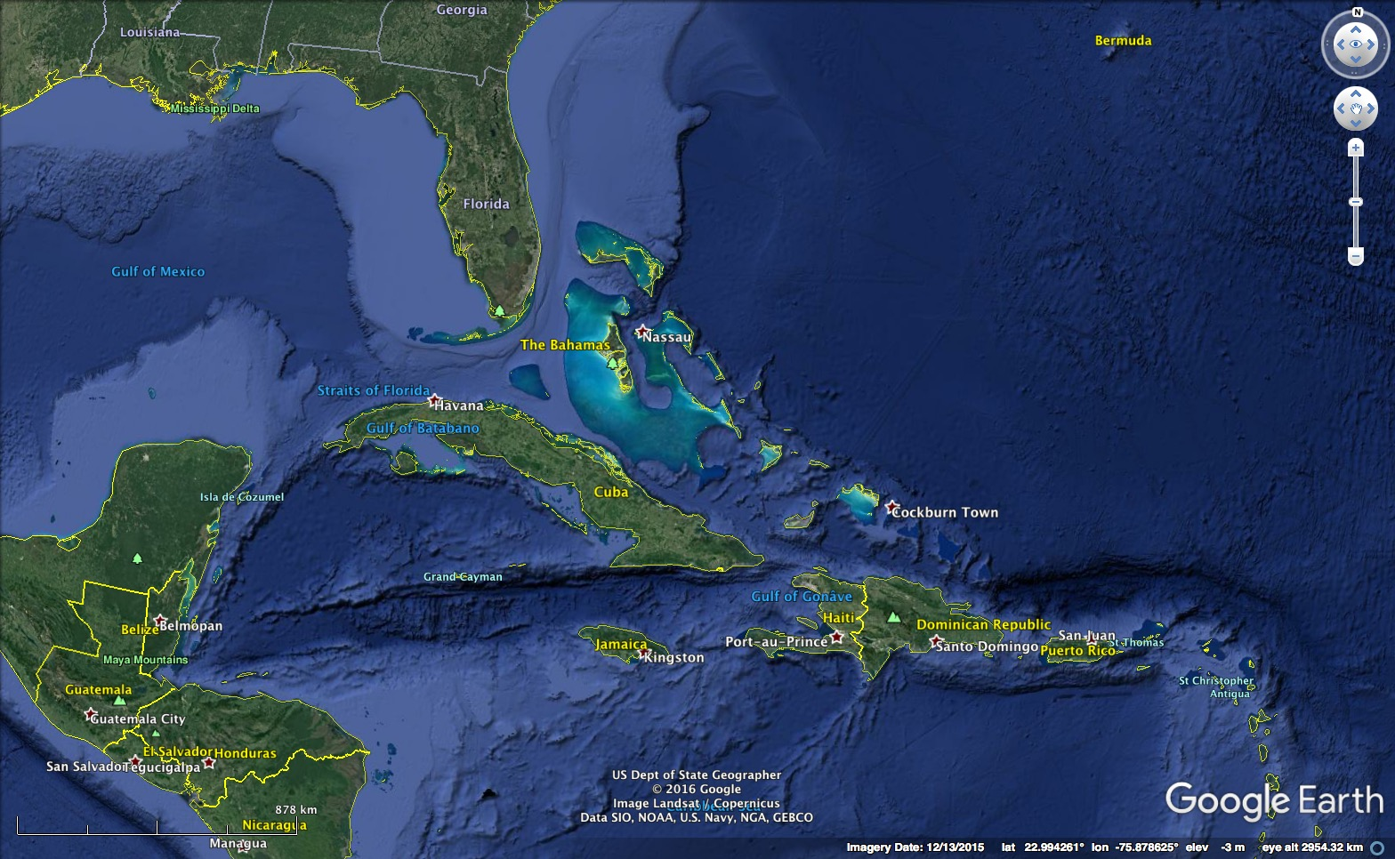

Slide 10
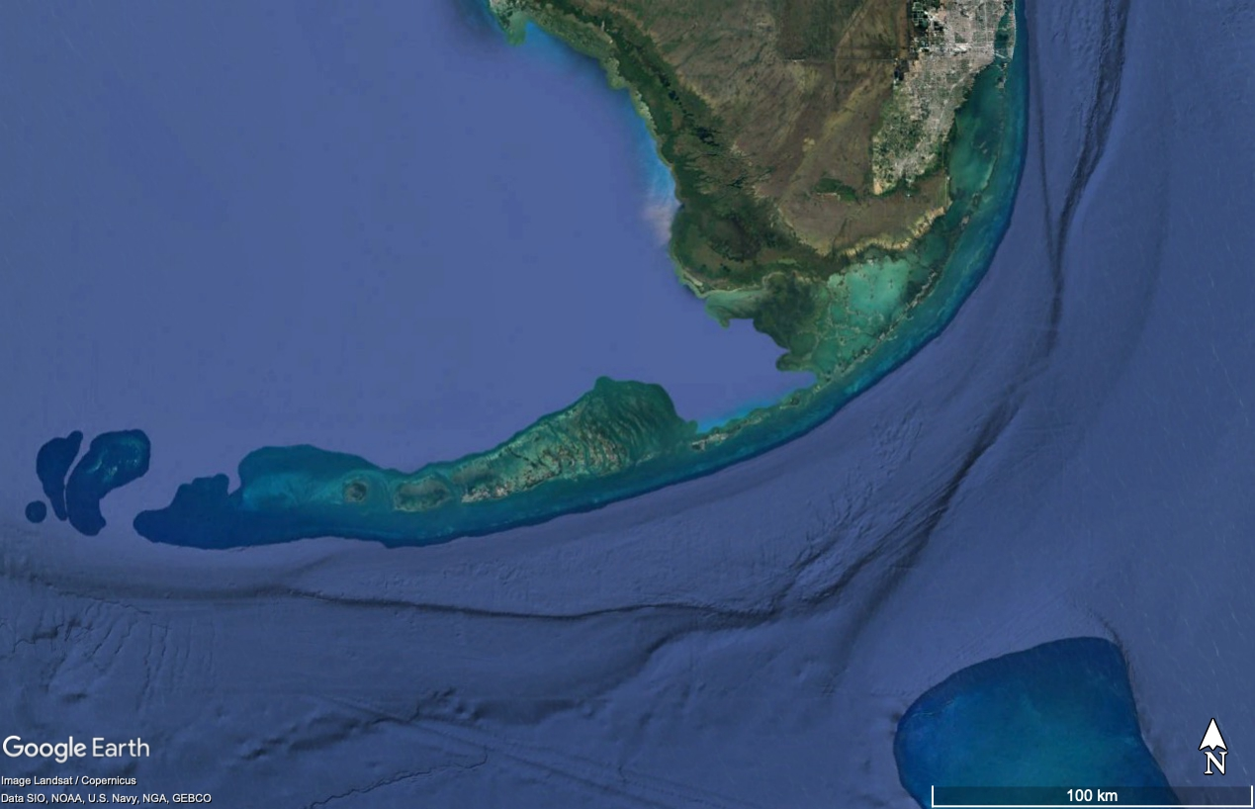
Notes:
coral cay archipelago

Slide 11
FACT, iTAG, MATOS (ACT), OTN

Slide 12
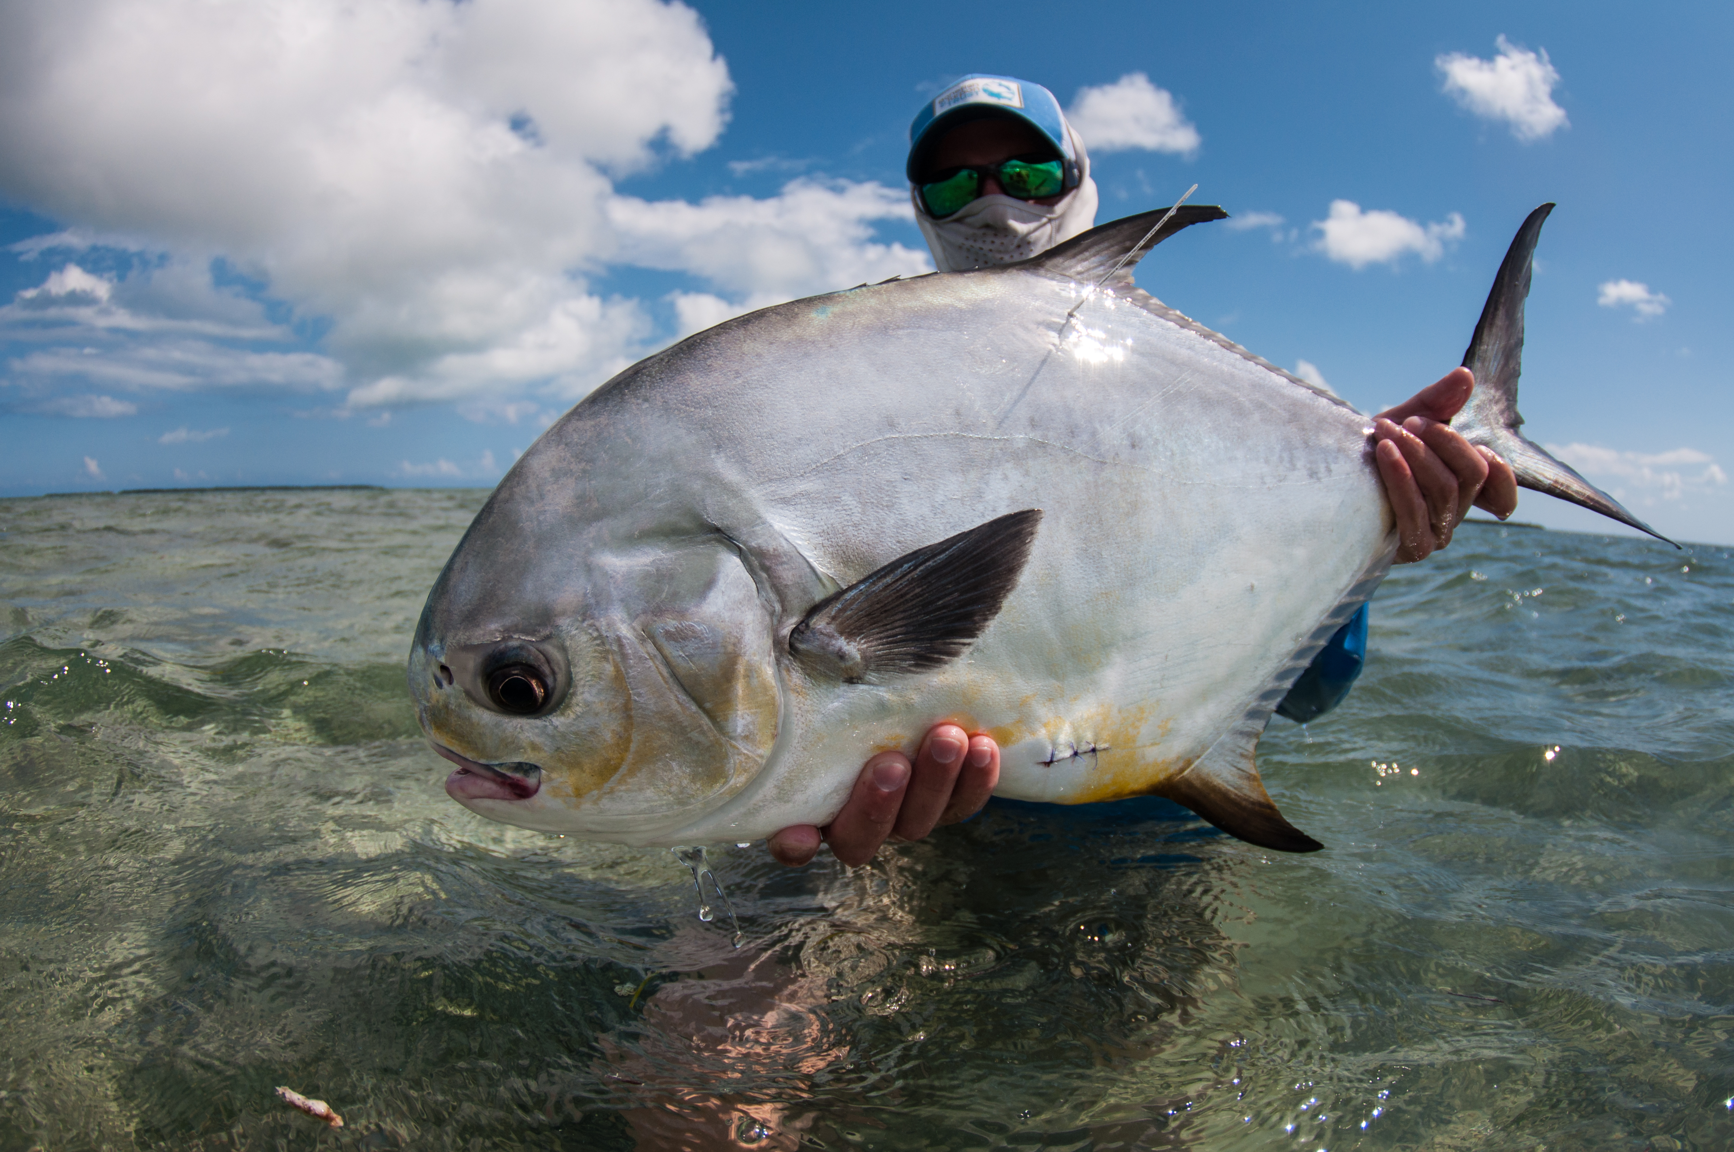
Permit (Trachinotus falcatus)
Permit (Trachinotus falcatus)

Slide 17
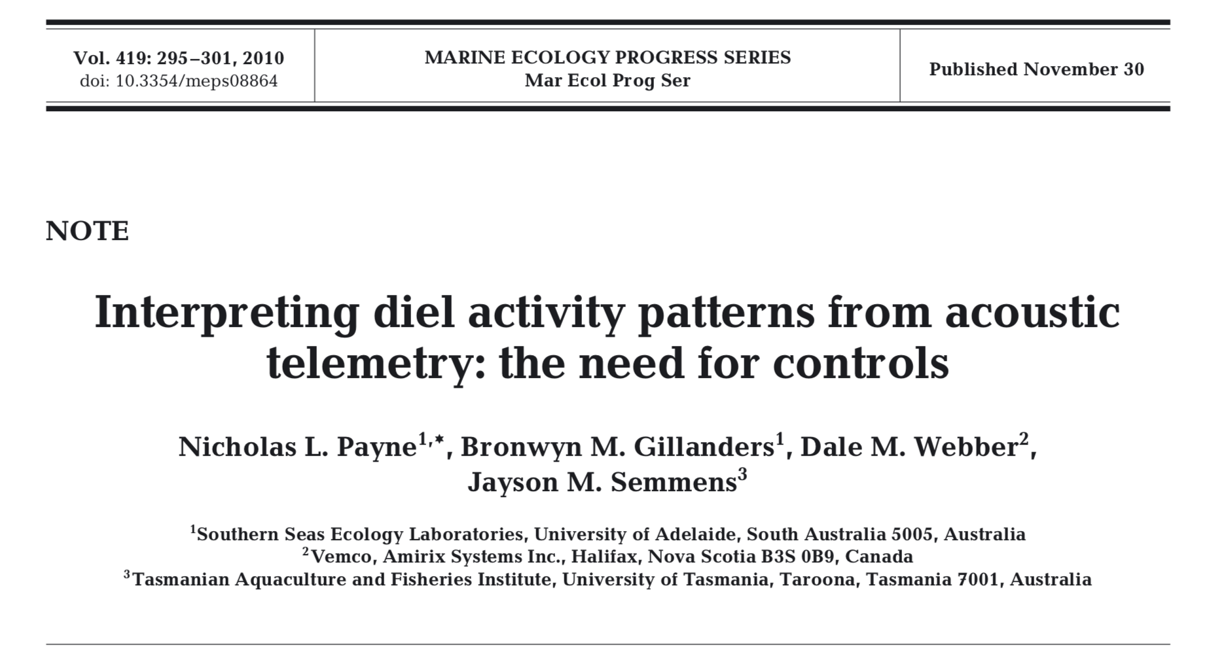
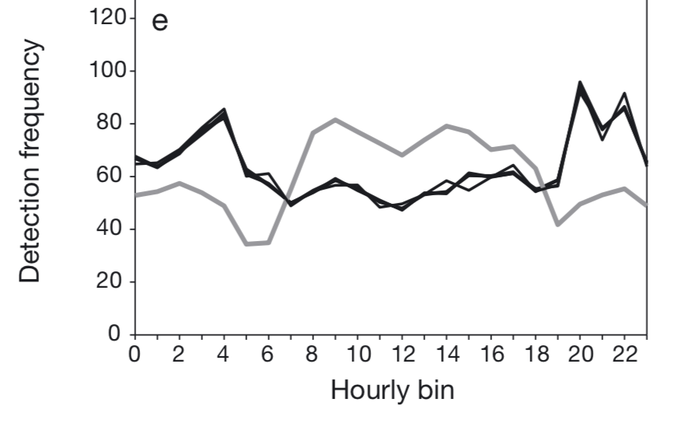
Corrected detections
Raw detections

Slide 18
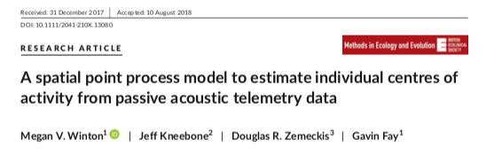
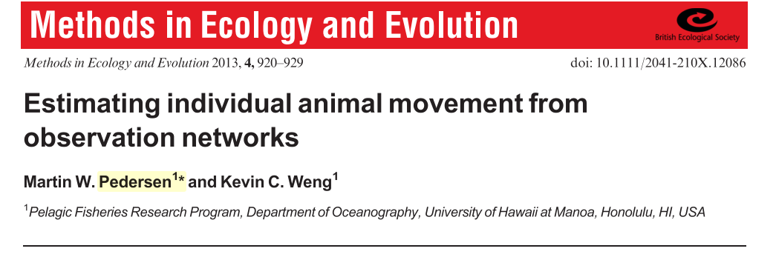

Slide 19
